Slide 1

Optimizing content An approach
Patrick Lajeunesse Digital Transformation Office @patlaj
Notes:
This is UX 201, more for people who know the basics of what UX design is and want to apply it in their work.
Voici le cours d’Expérience utilisateur 201, qui s’adresse aux personnes qui connaissent les rudiments de la conception d’expérience utilisateur et veulent l’appliquer à leur travail.
But to be honest, anyone who is producing content for the web can benefit.

Slide 2
A recipe for web optimization
A tested approach for web optimization projects that you can use
Research and test with users (GC Digital Standard #1!)
It will cost money - but rewards are great
Notes:
You need to identify all of the stakeholders - particularly those who will have an impact on whether what you’re doing goes live. You can be stopped if the right people aren’t involved early on.

Slide 3
Approach overview
Problem definition
Baseline test
Design
Re-test
Success?
Launch
1
2
3
4
Task-test the current content with the public
Did prototype perform?
As determined by participating department(s)
User research, identify tasks to fix
Fix content, develop prototype, test and iterate
Task-test the prototype with the public, iterate to improve
Notes:
These aren’t phases so much as they are points you need to reach in your process

Slide 4
Getting set for success
Having the right people involved is key.
Find out who the real stakeholders are
Everyone should attend the kick-off
Key people need to be involved in problem definition, discovery and design
Everyone should view the test results (both baseline and final)
Notes:
You need to identify all of the stakeholders - particularly those who will have an impact on whether what you’re doing goes live. You can be stopped if the right people aren’t involved early on.

Slide 5
Research
“Asking your own questions and knowing how to find the answers is a critical part of being a designer”
- Erika Hall, Just Enough Research
Notes:
Research. That’s all about figuring out what you don’t know, and what you need to know to meet the goals of your project.
This is really a critical part of user-centred design.
Erika Hall has a great quote in “Just enough research” (which is a great book that’s definitely worth reading). She says, “Asking your own questions and knowing how to find the answers is a critical part of being a designer”.
You may say, “Yeah, but I’m not a designer”, but I agree with Jared Spool when he says that anyone who influences the design is in fact a designer. And that includes you, and it includes the DG or ADM who makes certain changes before it goes live. You have to see them as designers because that helps to frame what their influence is.
We put these “things we don’t know” into research questions, and they’re the things we’re going to try to answer with our research.

Slide 6
Problem definition
1

Slide 7
Discovery
Sometimes you can’t choose your projects… but you should choose what to focus on. Solve real problems.
What issues are call centres reporting?
What do analytics tell you about user behaviour?
What do people who use (or could use) the service say?
Are there other sources of information? (past research, discussion forums, Twitter)

Slide 8
Tasks
Tasks are what people are trying to do or what question they’re trying to answer.
Find out when parental leave ends
See if your passport can be renewed
Get your T4
Fill out a training form
These must be real things people are trying to accomplish.
Then can be broader or more detailed depending on your project needs.
Notes:
Tasks are a lower level than goals, which is what you’re actually trying to achieve.

Slide 9
Scenarios
Scenarios are narratives that can be used to test tasks.
Find out when parental leave ends:
“Marie is on parental leave and planning for her return to work. How can she find out when her last payment will be?”
Validate and test your scenarios!
Notes:
The other output of course is what you learned from the research

Slide 10
Baseline test
2
Notes:
Figure out things are currently performing - you have your tasks - let people try to accomplish them with your site

Slide 11
Get a baseline measure
Many options depending on your needs and resources:
Moderated usability testing
Unmoderated usability testing
Unmoderated tree/1st click testing
You have to test with actual (or potential) users.
Aim for ~16

Slide 12
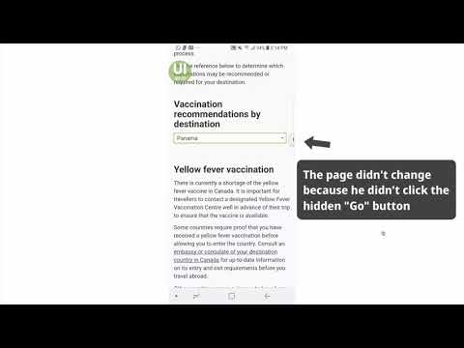
https://youtu.be/rRzbWCqfFO4
Notes:
You can learn a lot from even unmoderated participants...

Slide 13

Analyze the results
Notes:
After all of your testing is done, you need to analyze the results. Jakob Nielsen did a study where basically 6 users was enough to find a big chunk of the problems with an interface.
As I said, we measure 16-20 users, but that’s because we’re looking for enough people that any change is clear. You will want to use a number like that if you need to report on the percentage of successful participants. But if you’re looking for problems and trying to fix them you can get away with many fewer. Maybe 6-10 is reasonable.

Slide 14
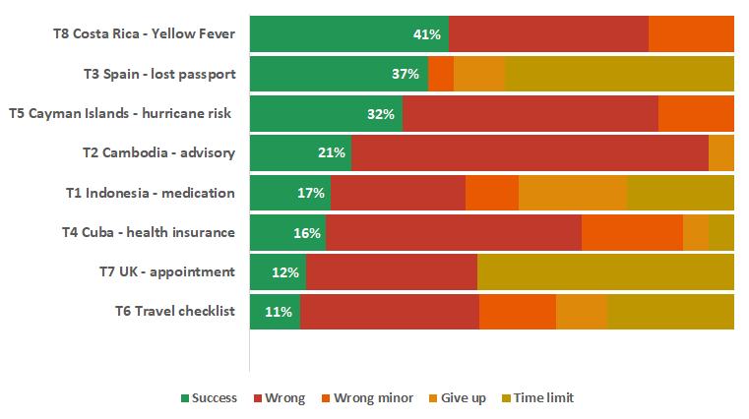
Sample baseline results

Slide 15
Design and prototype
3
Notes:
Figure out things are currently performing -

Slide 16
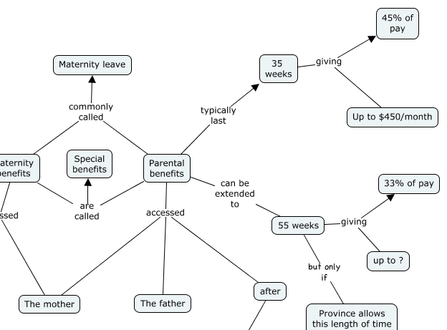
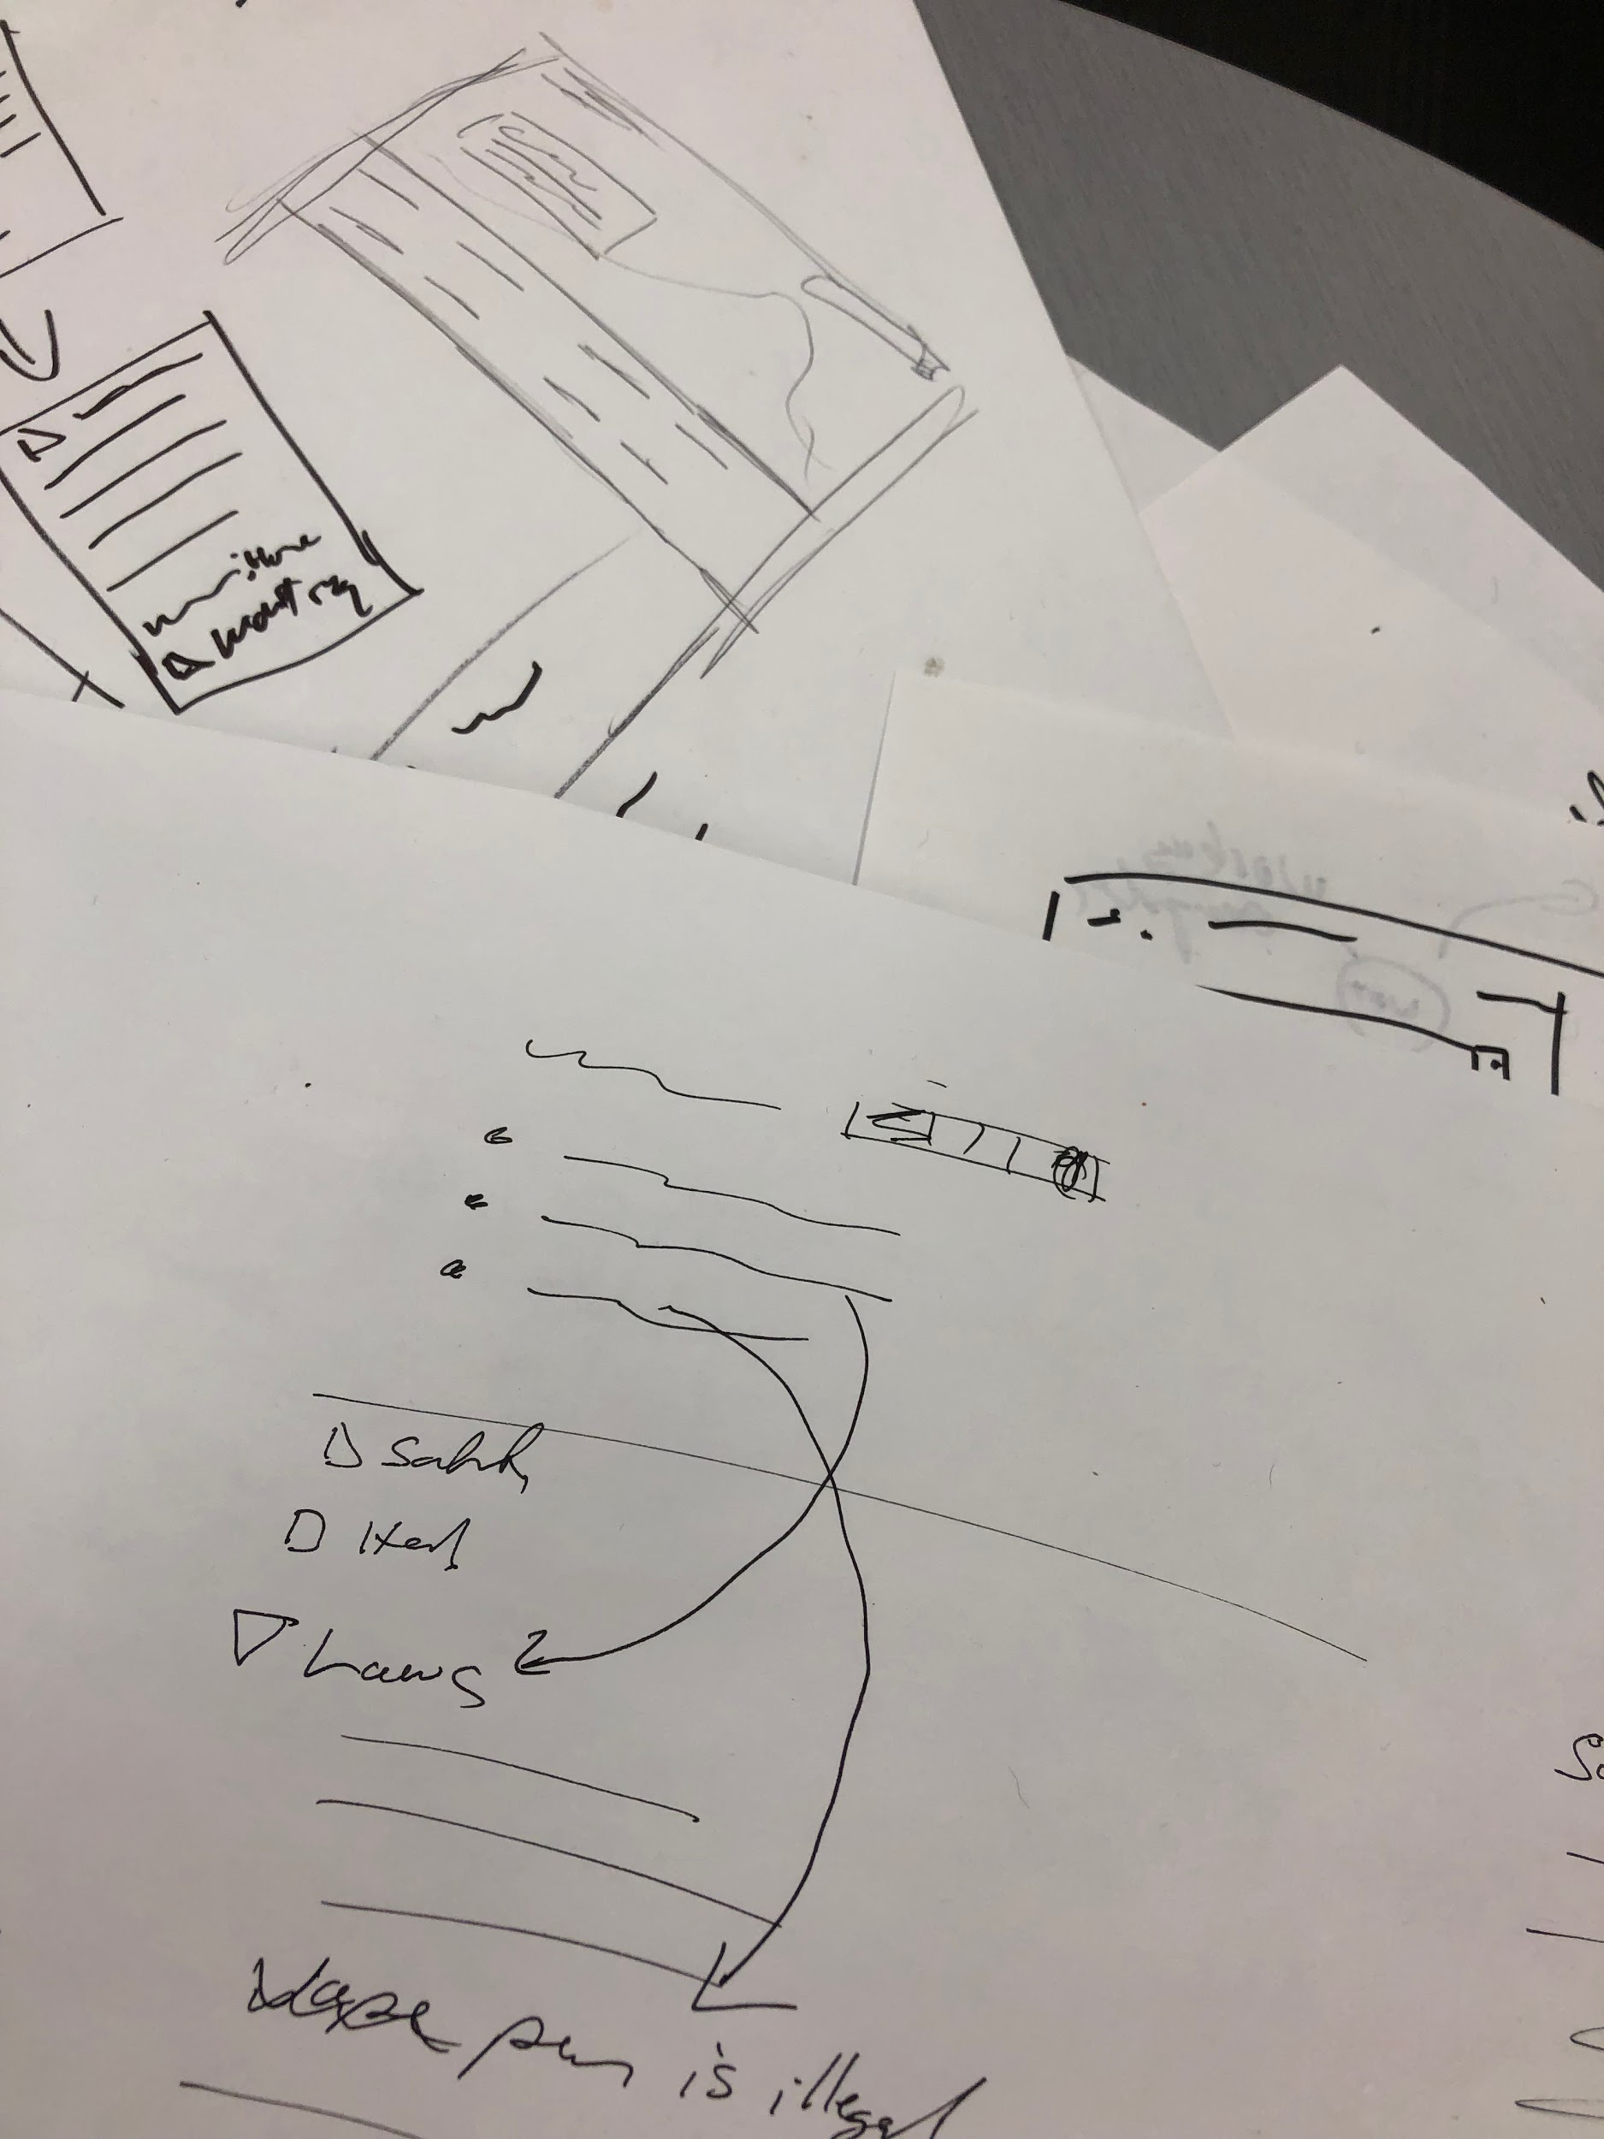
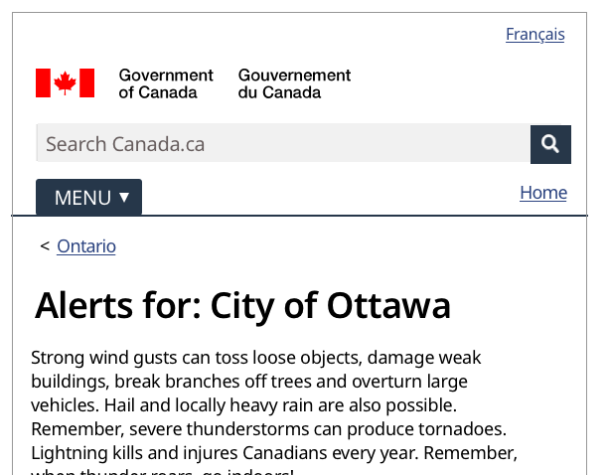
Sketch, learn, iterate
Notes:
Continue to work on understanding the issue as you work on solutions - Including more interviews, interviewing different people

Slide 17
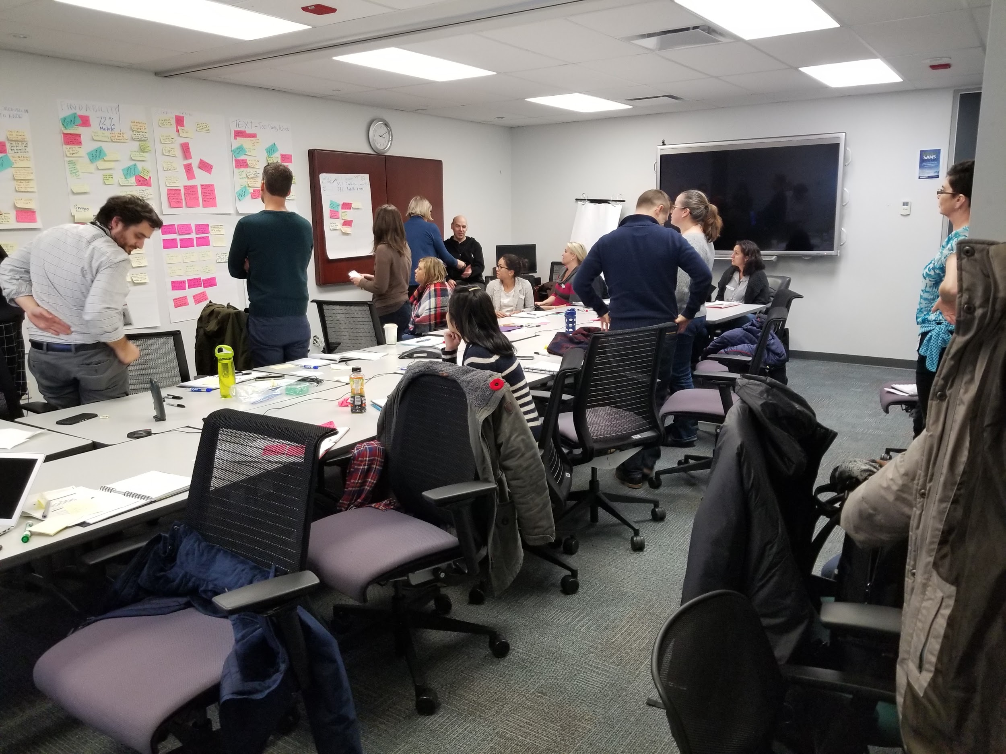
Co-design with your partners
Notes:
At the Digital Transformation Office, Une grande partie de notre travail consiste à travailler avec les ministères à des projets visant à améliorer des éléments clés des services gouvernementaux de base.
For now, these projects are limited in time to about 3-4 months, and so too is the scope.
Nous utilisons des techniques de recherche et de conception qui nous aident à bien comprendre le problème et qu’il faut faire pour l’ameiliorer.
We use some UX research and design techniques that help us get a good understanding of the problem and what we need to do.
Because we have such a short time, it’s important that we have practices that we can do quickly to learn about our projects and their users.
Since we’ve been doing this for a couple years now, we’ve learned some things that hopefully will be useful to you too.
---
Je suis actuellement chercheur en conception principal au Bureau de la transformation numérique du SCT. Une grande partie de notre travail consiste à travailler avec les ministères à des projets visant à améliorer des éléments clés des services gouvernementaux de base.
Nous consacrons habituellement de trois à quatre mois à un projet, en plus du temps consacré à la mise en œuvre.
Nous utilisons des techniques de recherche et de conception qui nous aident à bien comprendre le problème et qu’il faut faire.
Nous utilisons certaines des pratiques que nous aborderons aujourd’hui.

Slide 18
Move to a testable prototype
InVision
Axure
PowerPoint/Keynote
Github pages
Other web hosts
HTML pages on Github can be the easiest method
Notes:
Tasks are a lower level than goals, which is what you’re actually trying to achieve.

Slide 19
Re-test
4
Notes:
Same rough number of participants, same method of testing. Make changes

Slide 20
Analyze the (new) results

Slide 21
Success?
Notes:
Same rough number of participants, same method of testing. Make changes

Slide 22
Go live
Notes:
Same rough number of participants, same method of testing. Make changes

Slide 23
A few resources / Quelques ressources
GitHub
CDTS
Axure
InVision
Canada.ca Blog
Validately
TrymyUI
UserFeel
OptimalWorkshop
Books:
Just Enough Research, Erika Hall
Practical Design Discovery, Dan Brown
Interviewing Users, Steve Portigal
Rocket Surgery Made Easy, Steve Krug

Slide 24
Questions?
Patrick Lajeunesse
Senior Design Researcher
Digital Transformation Office
Treasury Board Secretariat
patrick.lajeunesse@tbs-sct.gc.ca
Notes:
OK so we still have time for questions. And as I said, you can reach me if you have other questions or want to talk about anything else in particular.
Thanks!

